Slide 1
Microservices and DevOps
DevOps and Container Technology
Cloud Computing
Henrik Bærbak Christensen

Slide 2
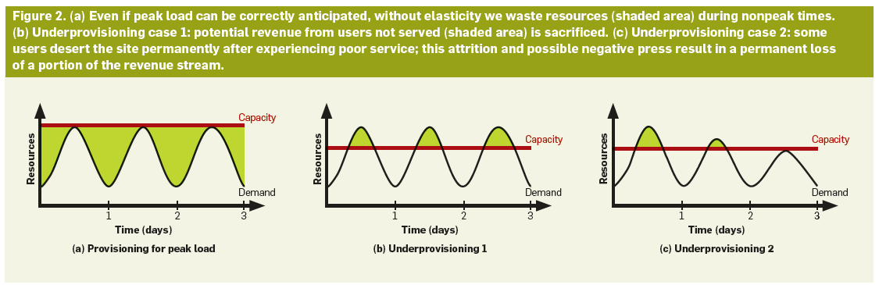
Why?
Utilization Problem

Slide 3
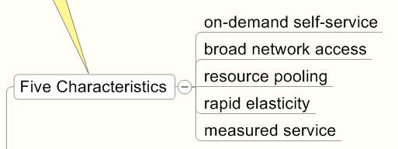
NIST characteristics
A short and on the spot paper: the NIST paper

Slide 4
Service Models
SaaS: Software as a service
End user applications accessible in the cloud, typically through web browsers
Exercise: Give examples
PaaS: Platform as a service
Programming libraries, services, tools allowing applications to be build utilizing cloud features
Exercise: Give examples
Notes:
SaaS: Gmail, google maps, google docs, ....
PaaS: Google App Engine

Slide 5
Service Models
IaaS: Infrastructure as a Service
Provide virtual processing and storage capacity, i.e. the actual computing infrastructure
Exercise: Give examples
FaaS: Function as a Service
Provide single function as a cloud hosted service
Aka ‘serverless architecture’
Notes:
IaaS: Amazon EC2

Slide 6
Comparing
Why are some cloud service models much easier to spot than others?
Notes:
Because PaaS is hidden from us users? Was this web site made using App Engine?

Slide 7
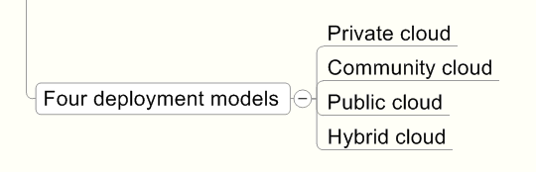
Deployment models

Slide 8
In Practice

Slide 9
Find yourself a suitable provider
Consider
Cost and how easy it is to calculate cost
I prefer flat rate models!
Free-tier if you want to save a few bucks
Learnability Spend 2 minutes or 5 hours?
My recommendations (I have no affilitation)
Cloud.dk support Danish industry
digitalocean one-click docker !

